Slide 1
Reloaded DenseNet (RDNet) for CIFAR10 with Quantization and Adversarial Attack considerations
Alex Darwiche, Cameron Halaby, Aditya Bhargava

Slide 2
Introduction
Transfer Learning to CIFAR10
Quantization
Adversarial Attacks
Conclusion and Future Directions
Agenda

Slide 3
Introduction
Our paper illustrated the power of Dense Networks, especially when they modernized the architecture and training formula.
They coined their improvements as the “RDNet” or Reloaded DenseNet. Their model was able to achieve state-of-the-art accuracy for classifying images within the ImageNet-1k dataset.
Project Pipeline:
Transfer Learned RDNet
Quantized RDNet
Performed Adversarial Attacks on RDNet
Tested Preprocessing techniques to mitigate attacks

Slide 4
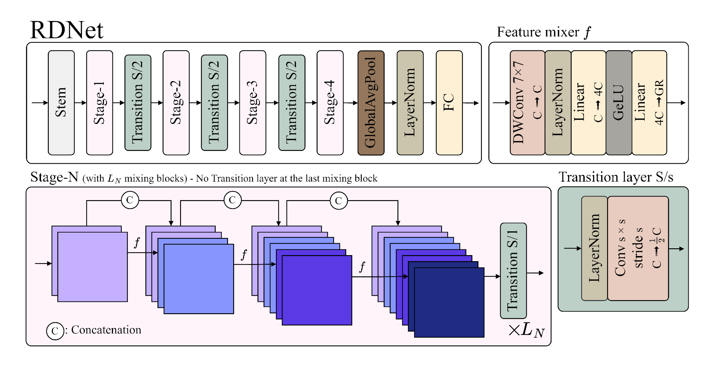
Model Architecture

Slide 5
Transfer Learning to CIFAR10
We first decided to take the architecture used for ImageNet-1k and attempt to transition that model to CIFAR 10 classification.
First, we needed to redefine the classifier head within RDNet (Switching from 1k to 10 classes)
Next, we trained on 45k training samples from CIFAR10 and Validating on 5k images
Results
Achieved 93.86% accuracy on the CIFAR10 dataset
Workflow:
Find pre trained model on ImageNet-1k on HuggingFace
Transfer that pretrained model to CIFAR10
Fine-tune on CIFAR10 testing data

Slide 6
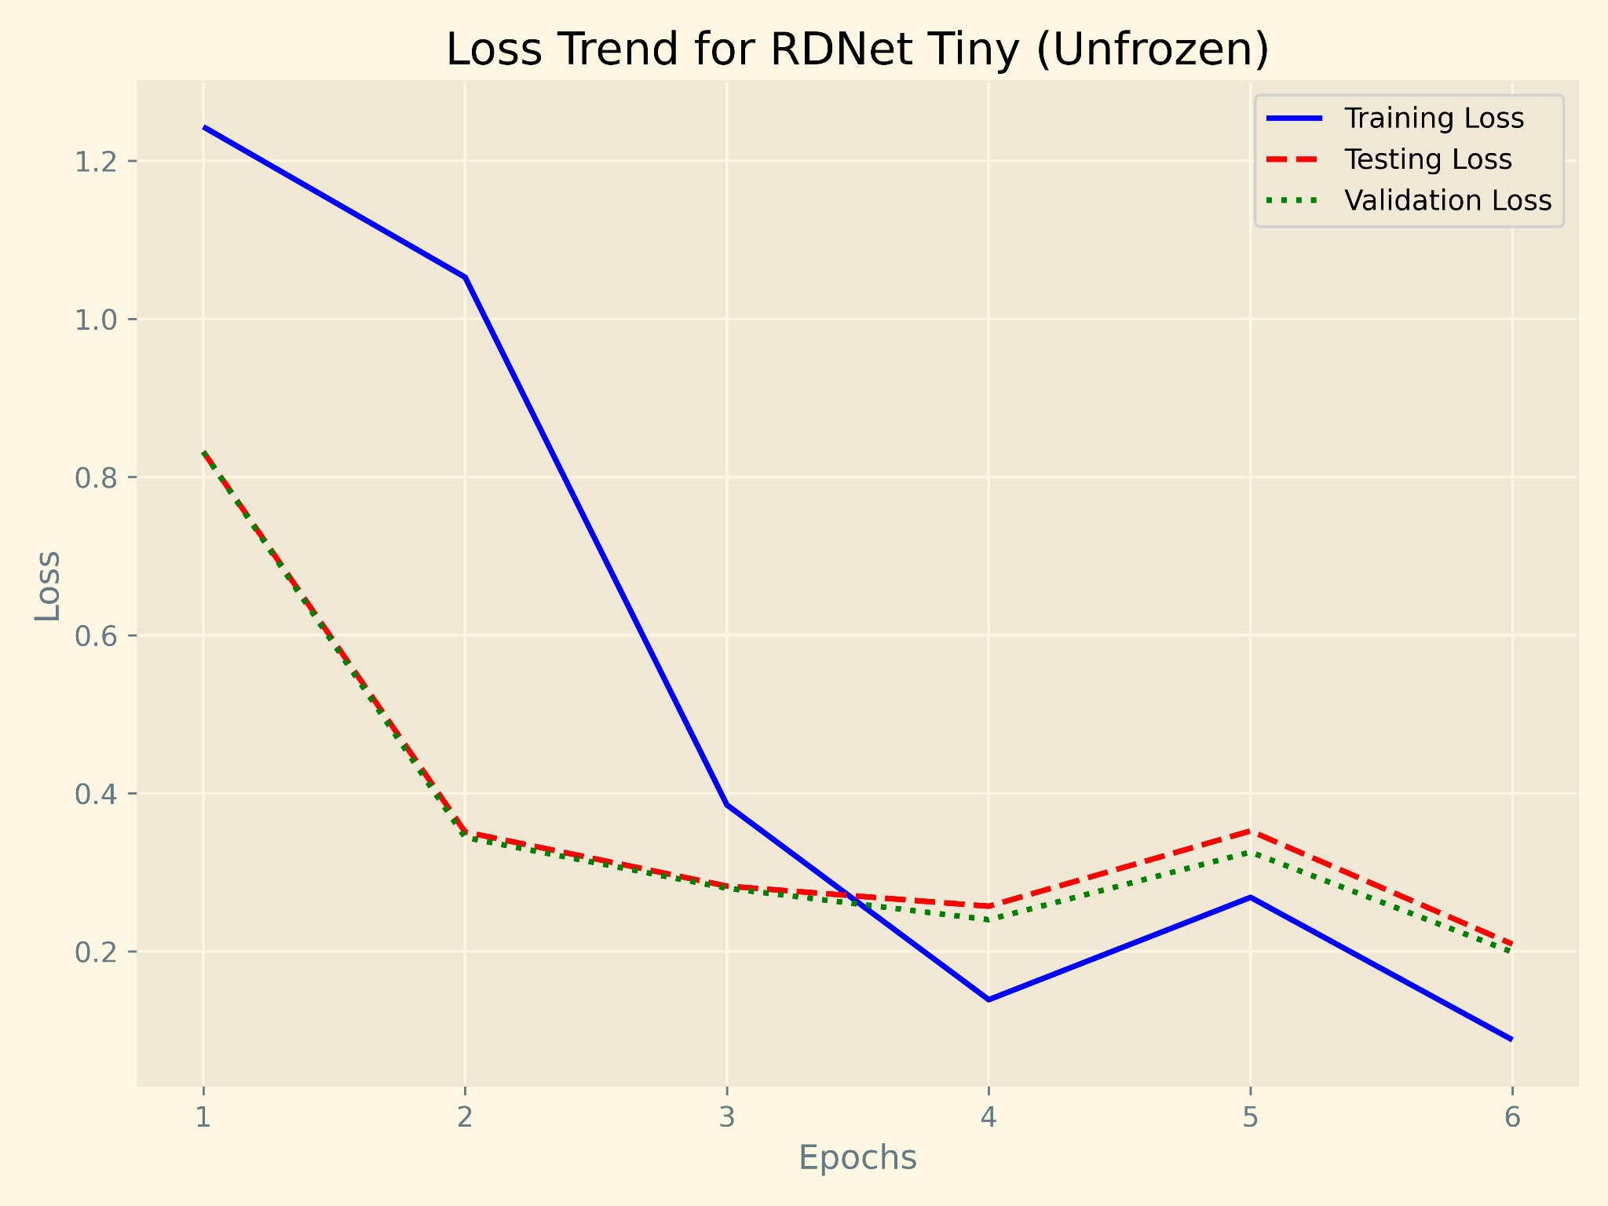
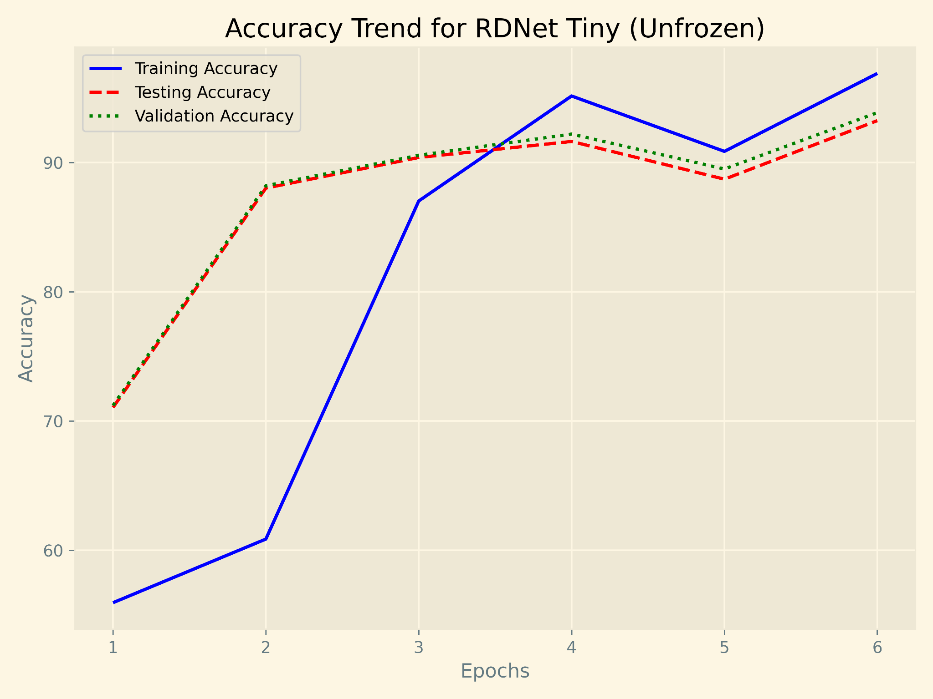
Transfer-Learning Results

Slide 7
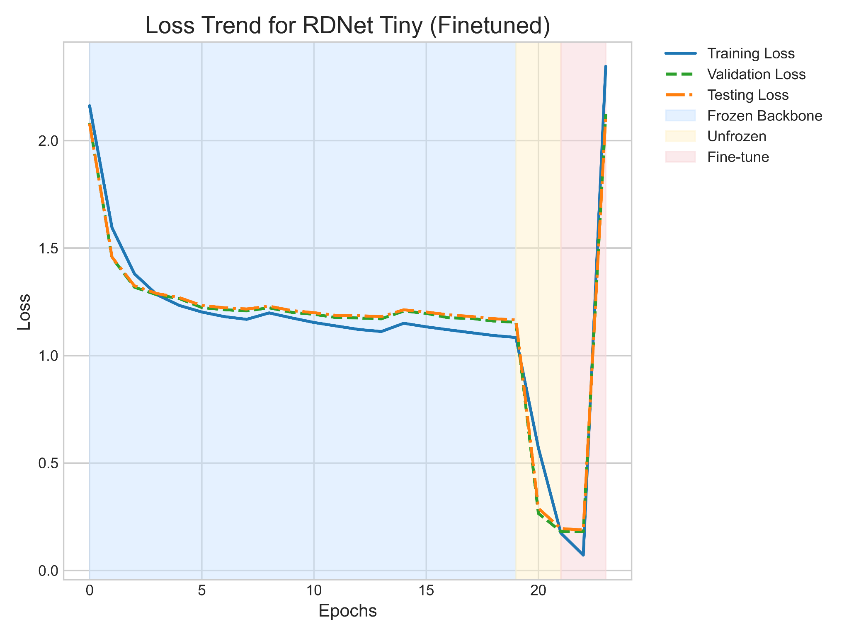
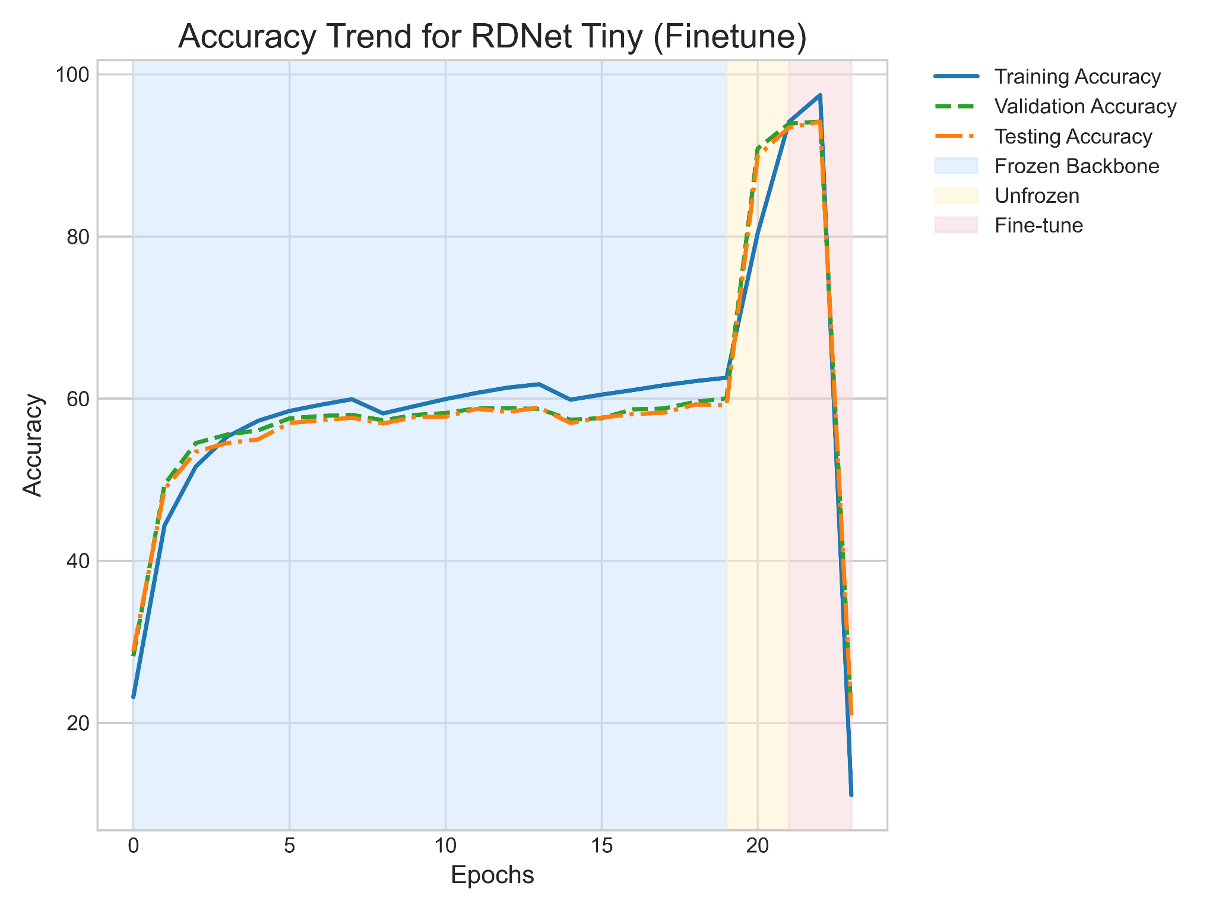
Fine Tuning Observations

Slide 8
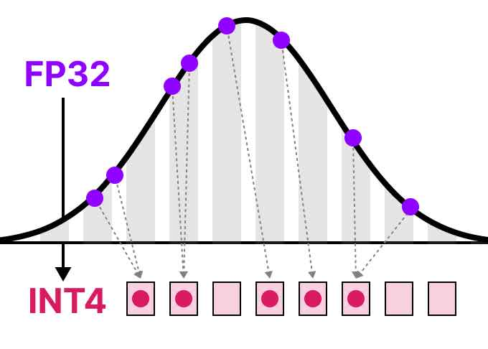
Quantizing RDNet
Our first proposed improvement for RDNet was quantizing the model, reducing its size from the original ~85MB size.
Quantization looks to reduce the size of the model, so as to allow the model to be deployable on smaller and smaller devices.

Slide 9
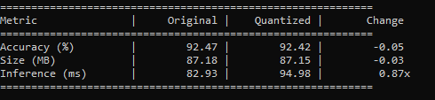
Quantization (PyTorch Dynamic)
First, we began by using the “dynamic_quantization” method provided PyTorch’s quantization submodule.
This method was not very effective on the RDNetTiny Architecture
Only the single Linear Layer (classifier head) is being quantized

Slide 10
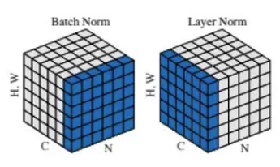
Quantization Challenges (Dynamic)
We then tried to use Batch Normalization instead of the common Layer Normalization used within the RDNet architecture.
However, the removal of the Layer Norms quickly degraded the accuracy of our pretrained RDNet to roughly 10%.

Slide 11
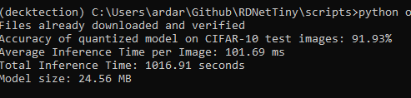
Onnx-Runtime Quantization
Onnx is a cross-platform machine-learning accelerator. This can dramatically improve inference times by applying graph optimizations and transforms.
General Onnx Workflow:
Export the model to Onnx.
Onnx assumes this computation graph is static
Onnx will optimize the computation graph for inference
Performs Fusions on Computation Graph
Apply Quantization (QDQ INT8)
Execute Inference

Slide 12
Quantization Results (Static)
We were able to reduce model size by roughly 75%, while still maintain nearly 92% classification accuracy on the CIFAR10 test dataset.
Reducing the size of RDNet will allow the model to be used on smaller devices.
Inference speed does see a 200% slowdown (Tested on Google Colab CPU)
Model | Accuracy | Average Inference Speed (ms) | Model Size (MB)
FP32 | 93.86% | 70.32 | 87.19
INT8 | 91.93% | 133.18 | 24.56

Slide 13
FLOPS/Parameters
For the MACs/FLOPs in the original FP32 model, we used the THOP package, similar to our project in class.
To calculate MACs/FLOPs in our Onnx Quantized model, we use the onnx_opcounter package from (https://github.com/gmalivenko/onnx-opcounter).
Model | Params | MACs | FLOPs
FP32 | 22.8M | 5B | 10B
INT8 | 22.8M | 5.3B | 10.6B

Slide 14
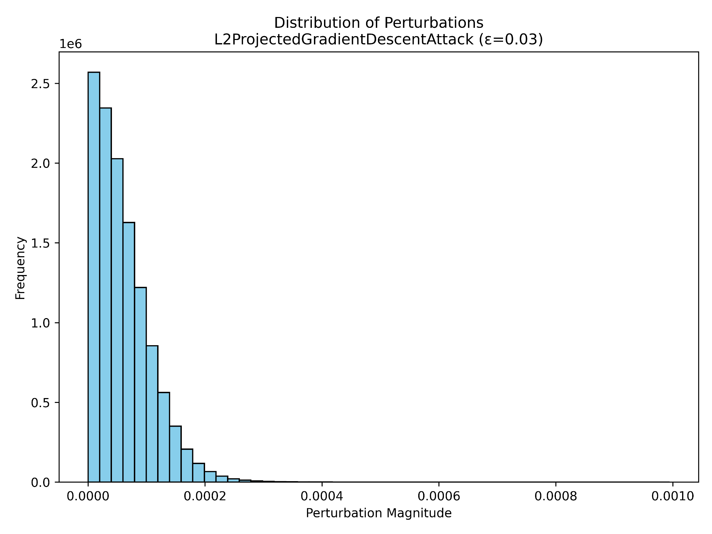
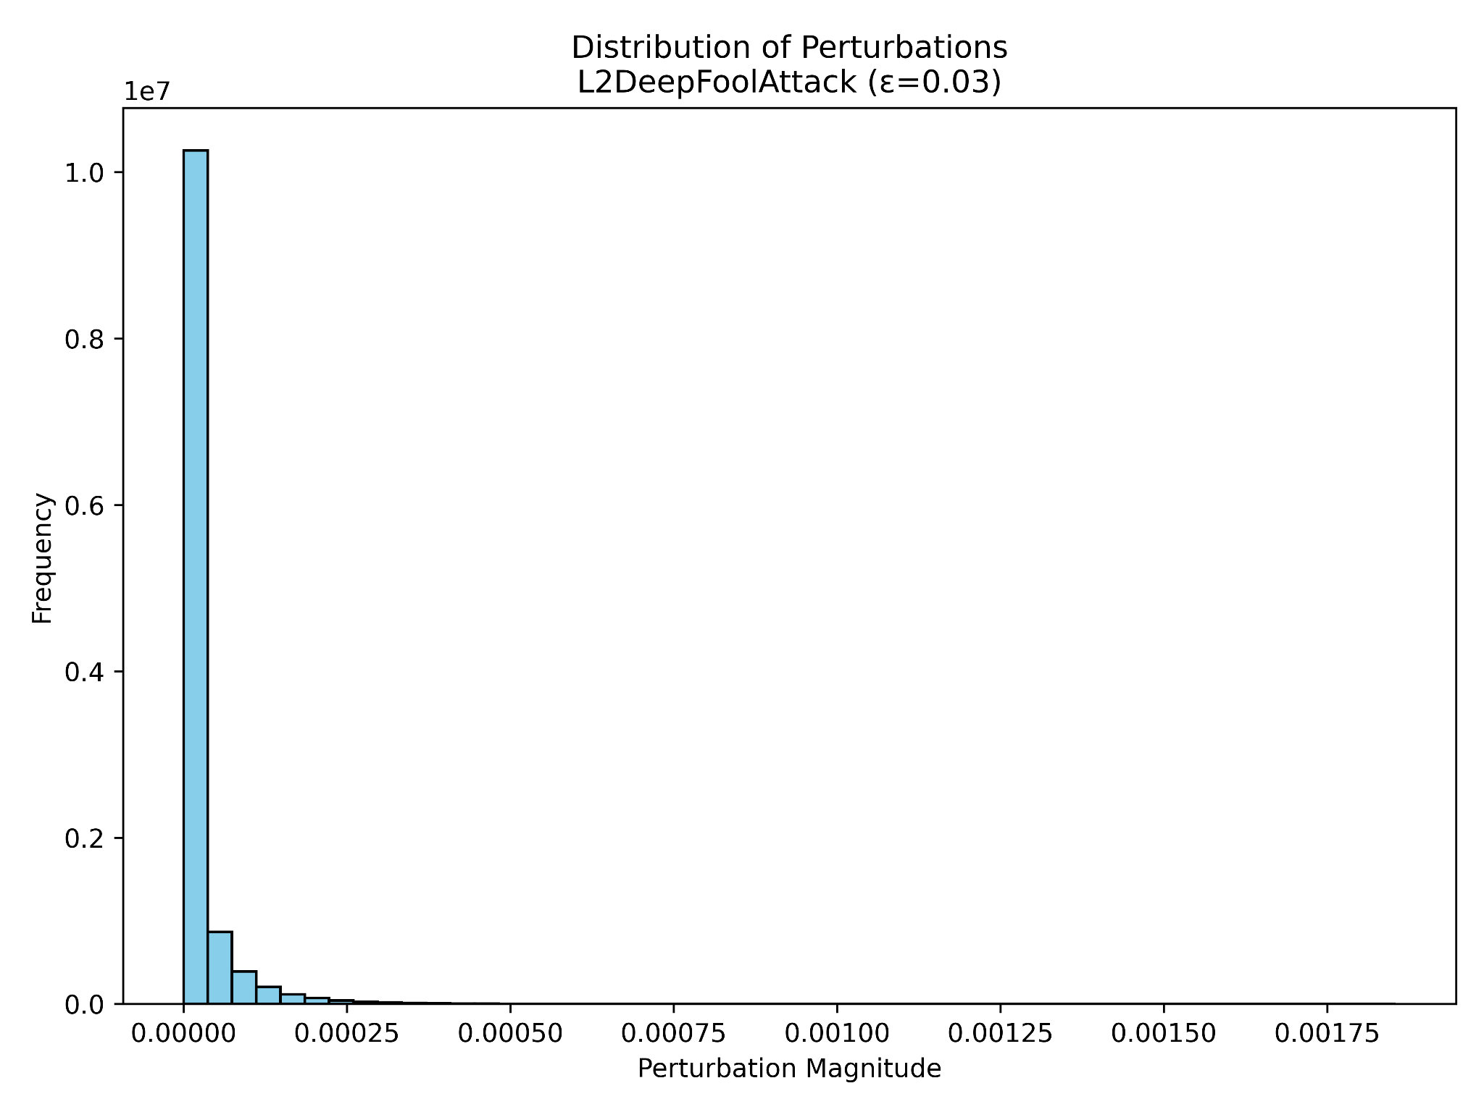
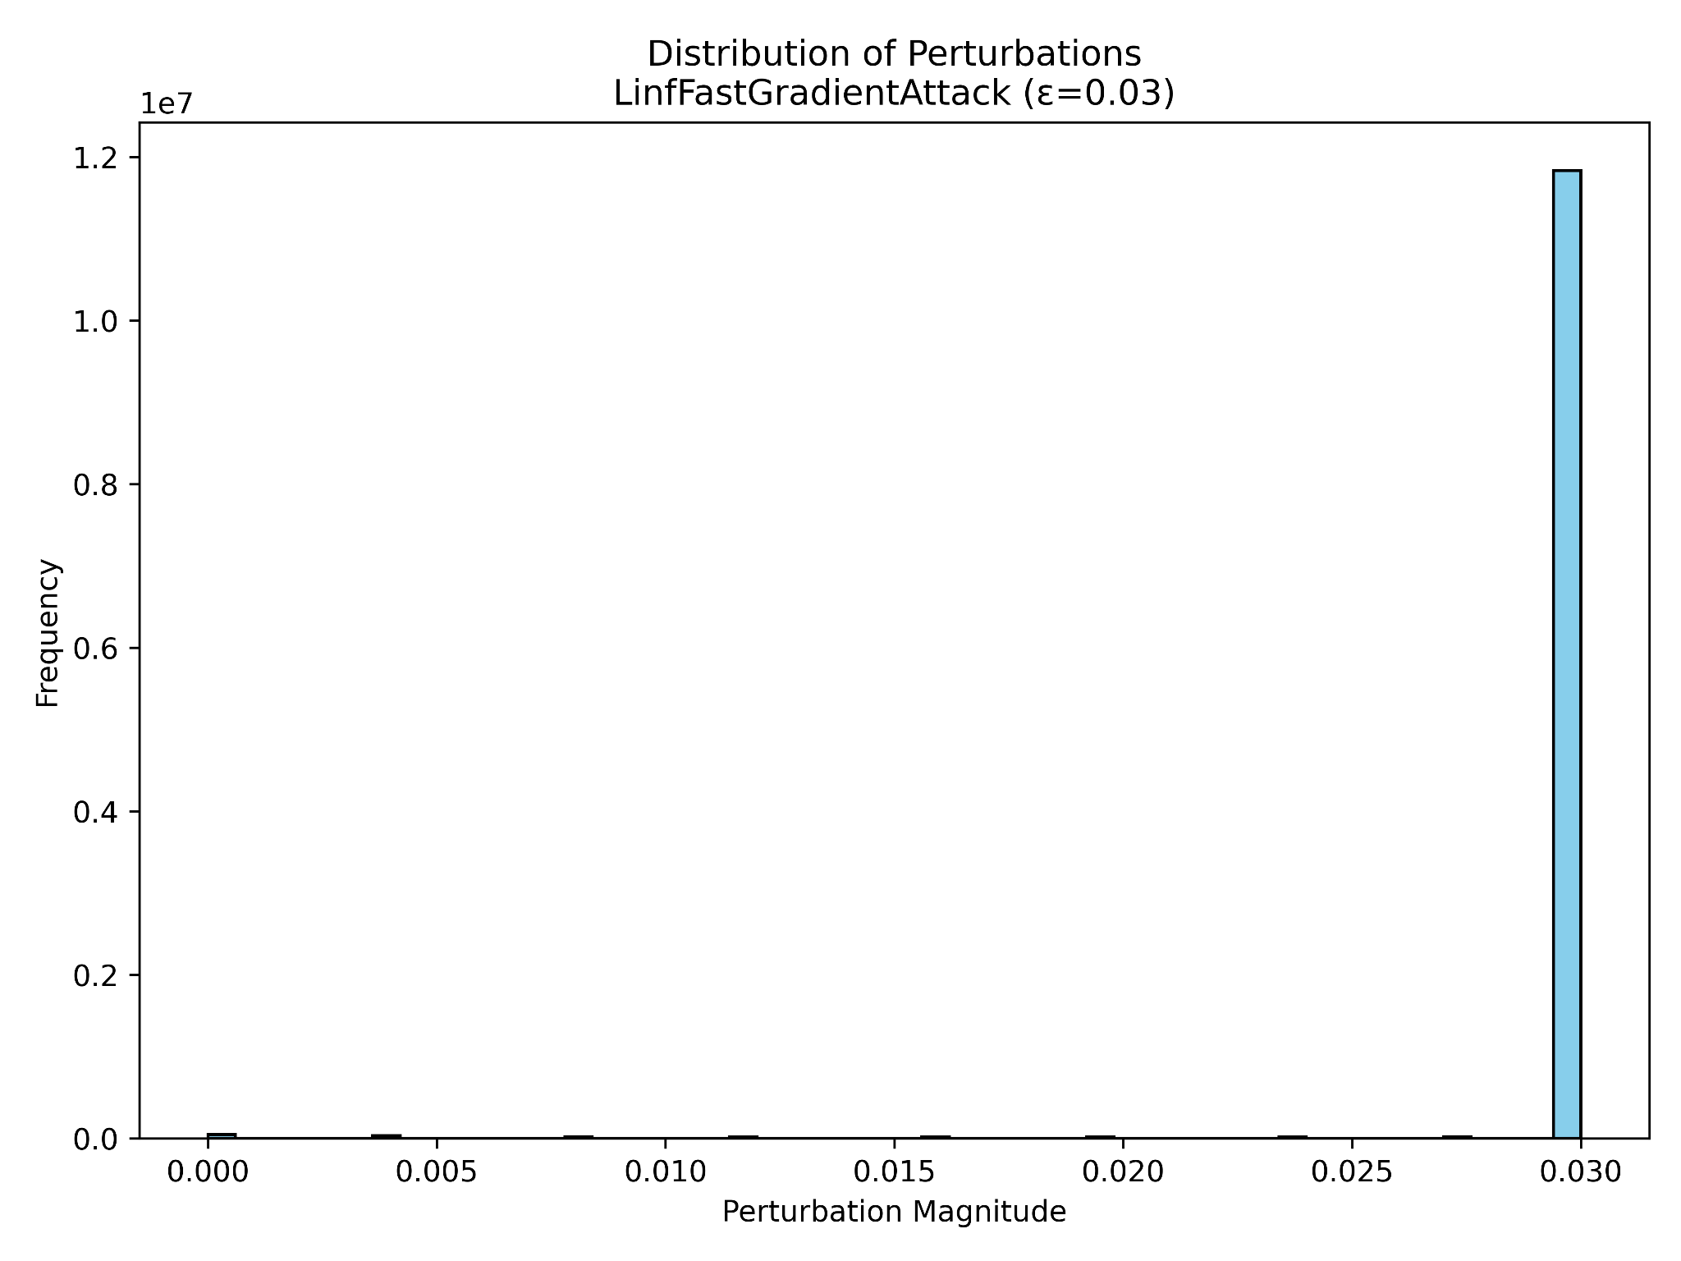
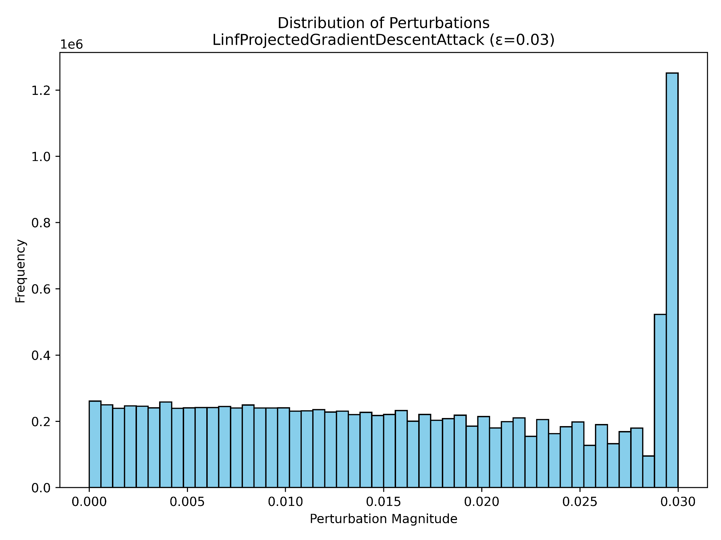
Adversarial Attacks
To test robustness, we applied the following 4 attacks on images that RDNet was attempting to classify:
L2PGD
LinfPGD
DeepFool
FGSM

Slide 15
Adversarial Attack Results
Attack Type | Attack Success Rate
FGSM (Fast Gradient Sign Method) | 87.50%
LinfPGD (L Infinity Projected Gradient Descent) | 100.00%
Deep Fool (L2 Deep Fool) | 56.25%
L2PGD (L2 Projected Gradient Descent) | 56.25%

Slide 16
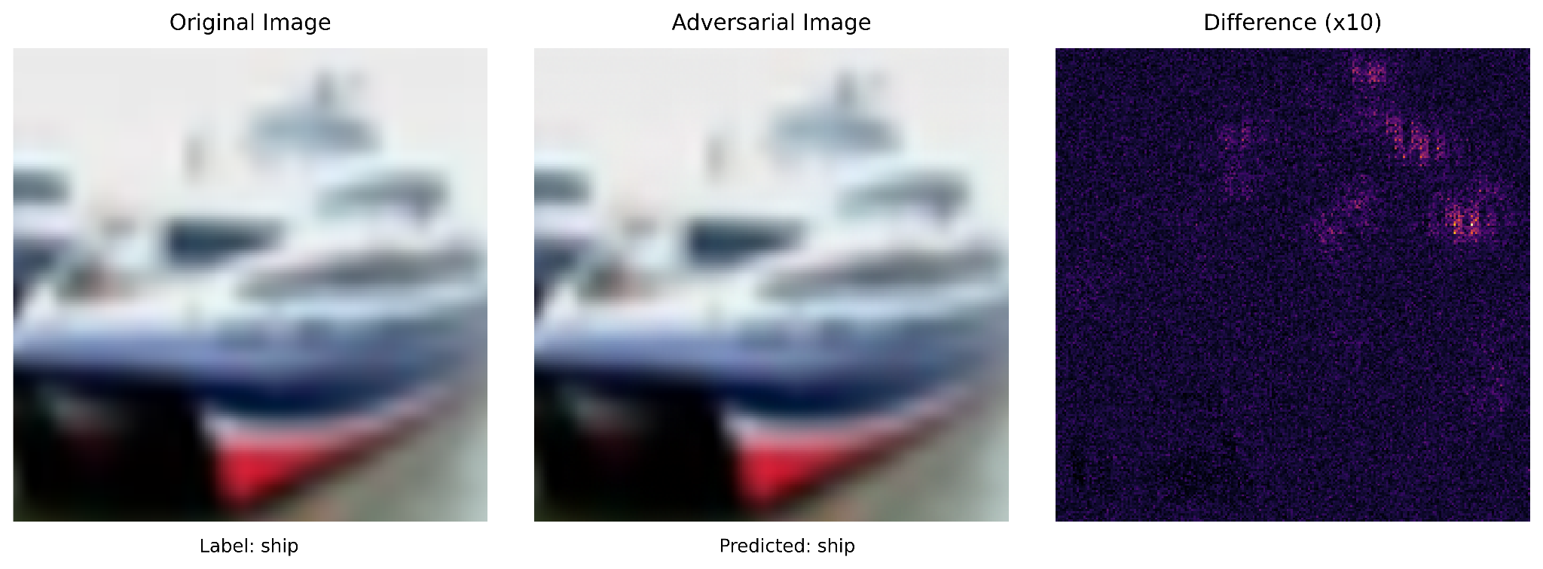
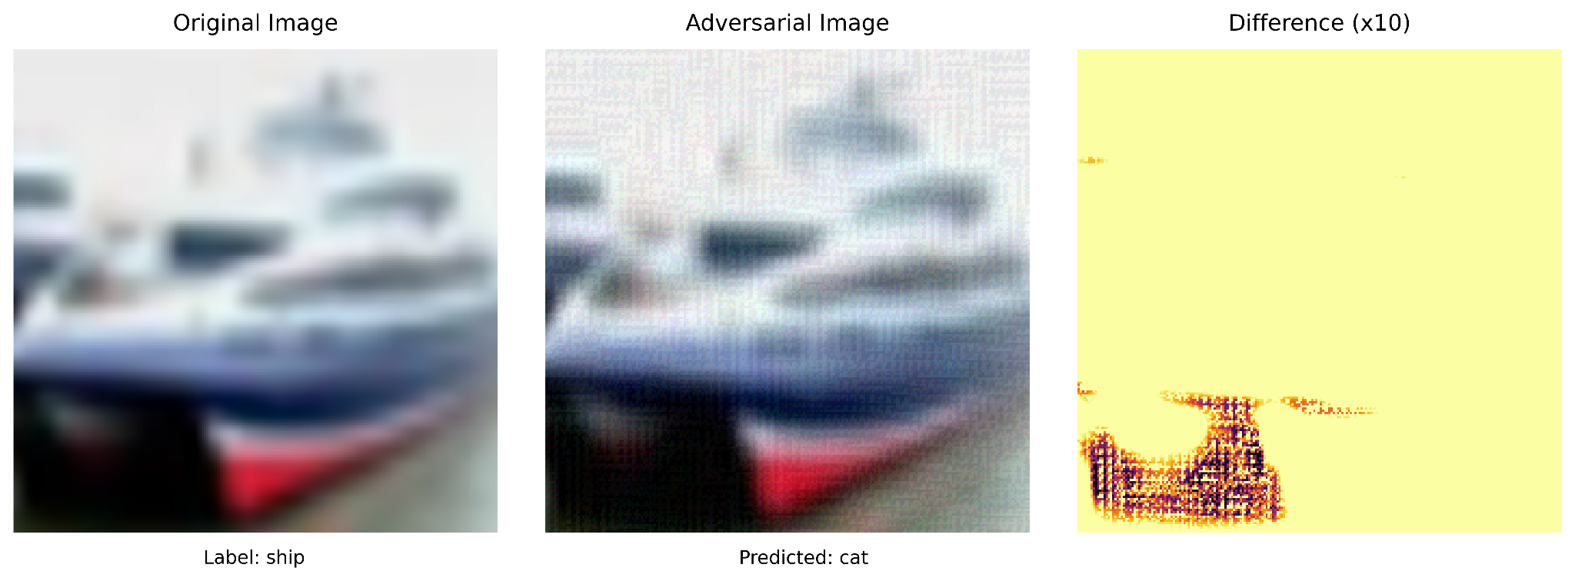
L2 Projected Gradient Descent
FGSM

Slide 17
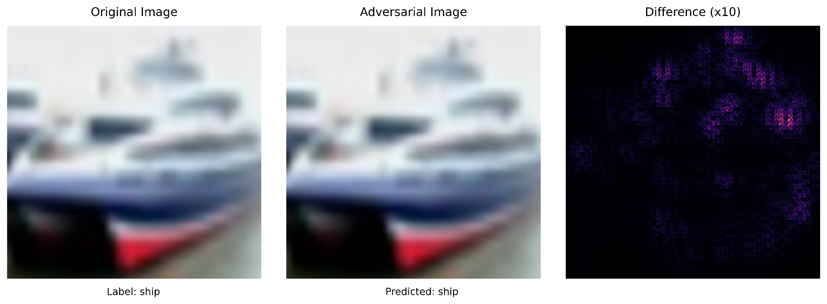
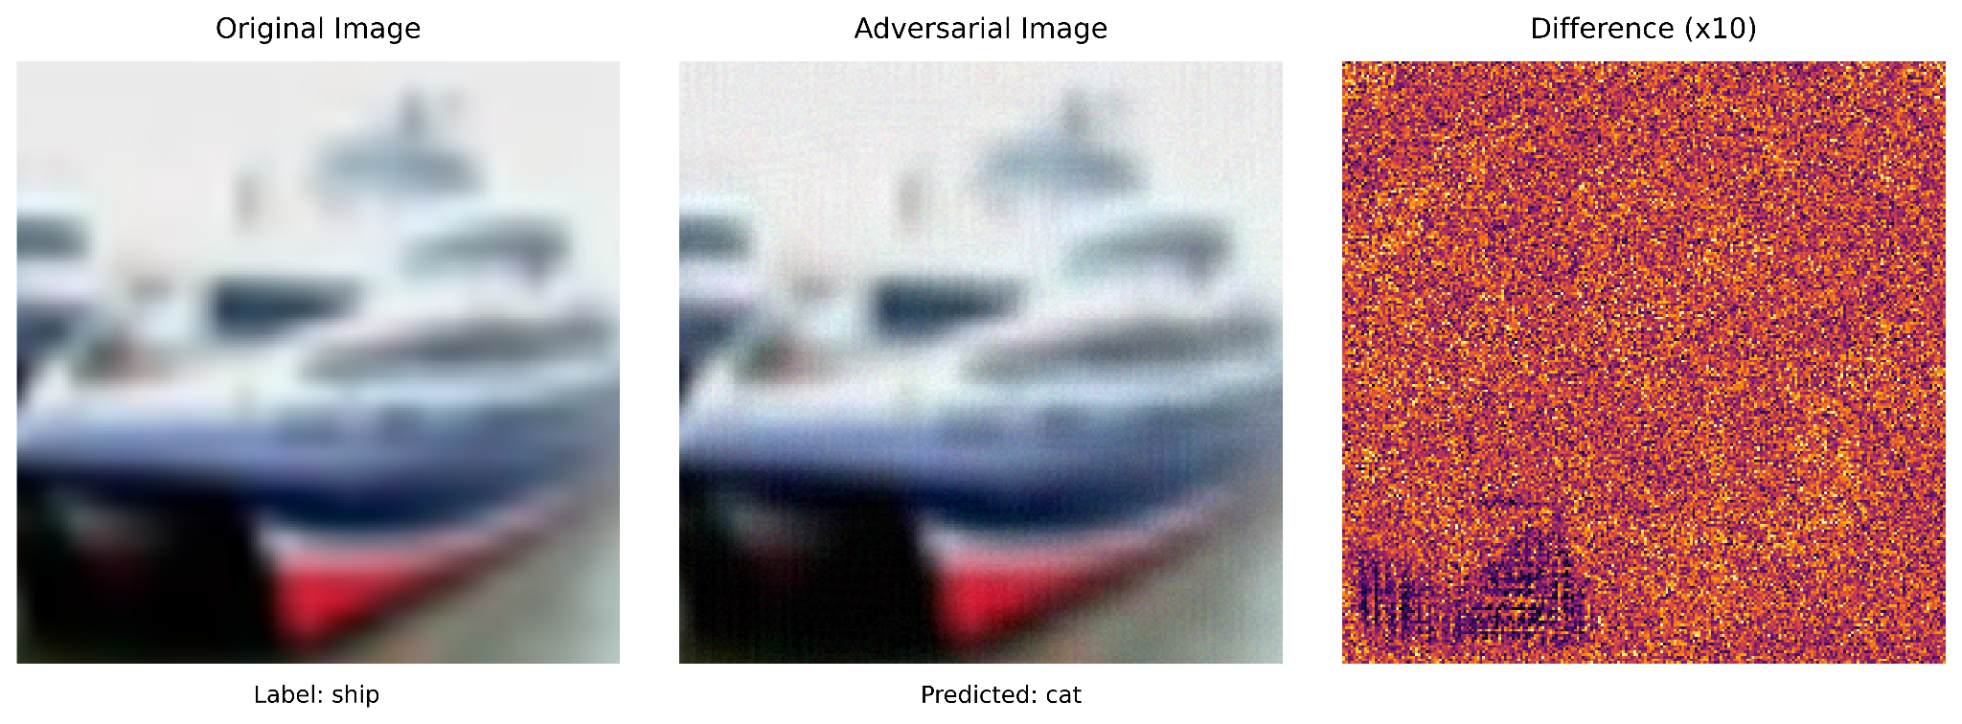
Deep Fool Attack
Linf Projected Gradient Descent

Slide 18
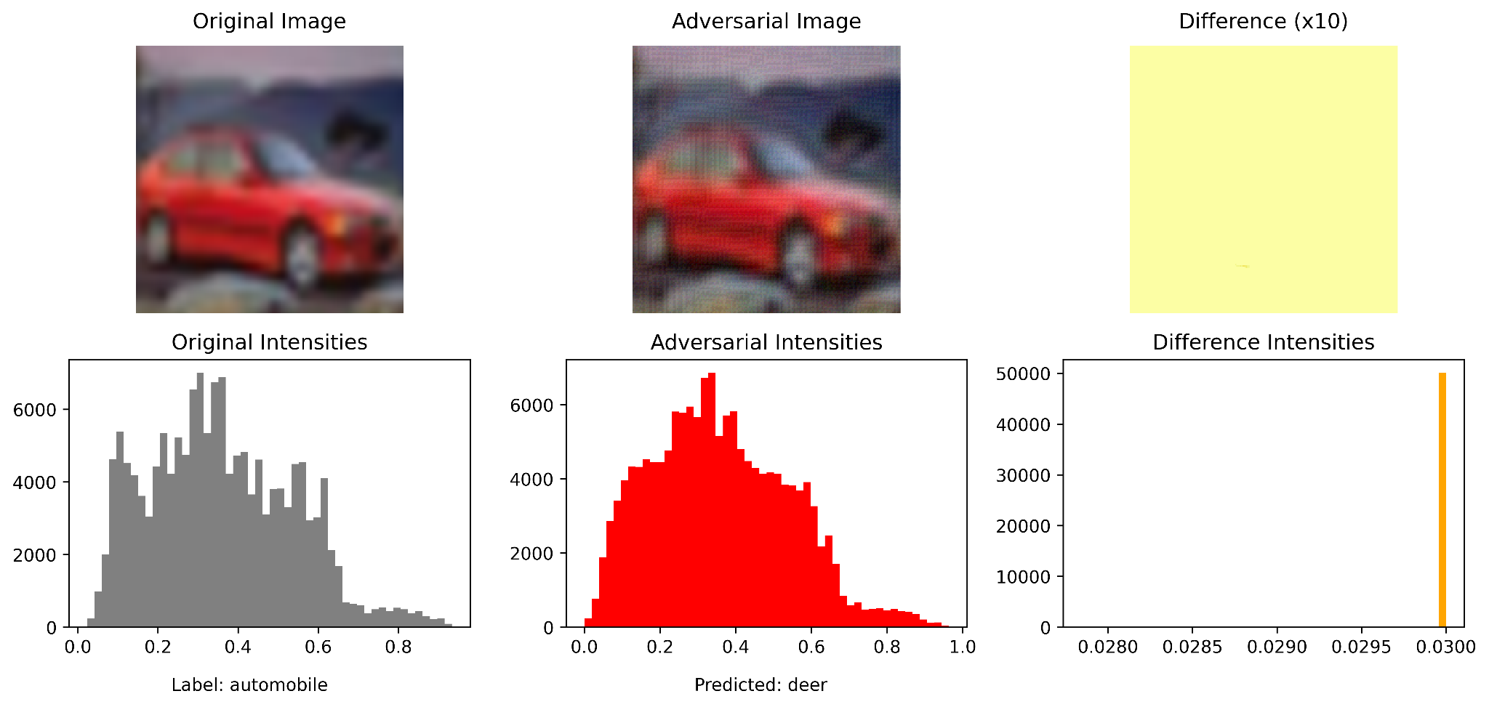
FGSM

Slide 19
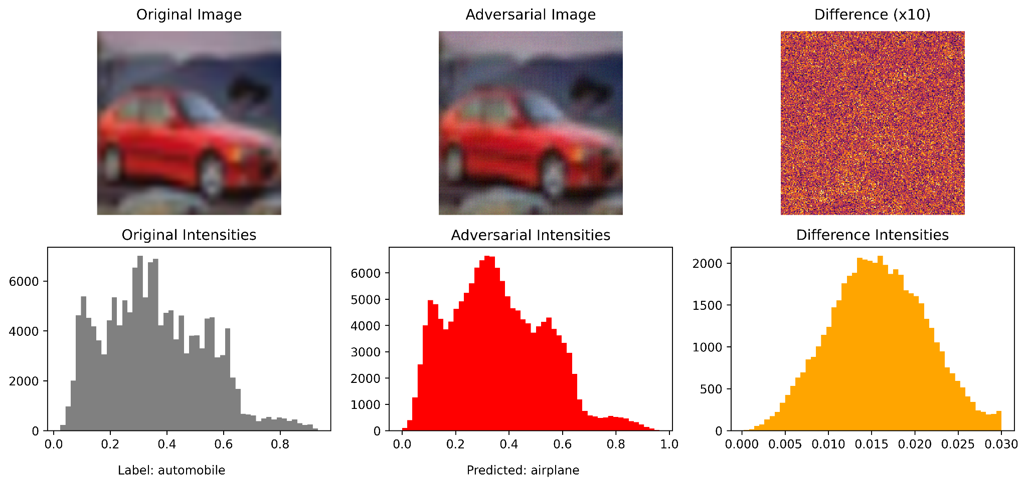
LinfPGD

Slide 20
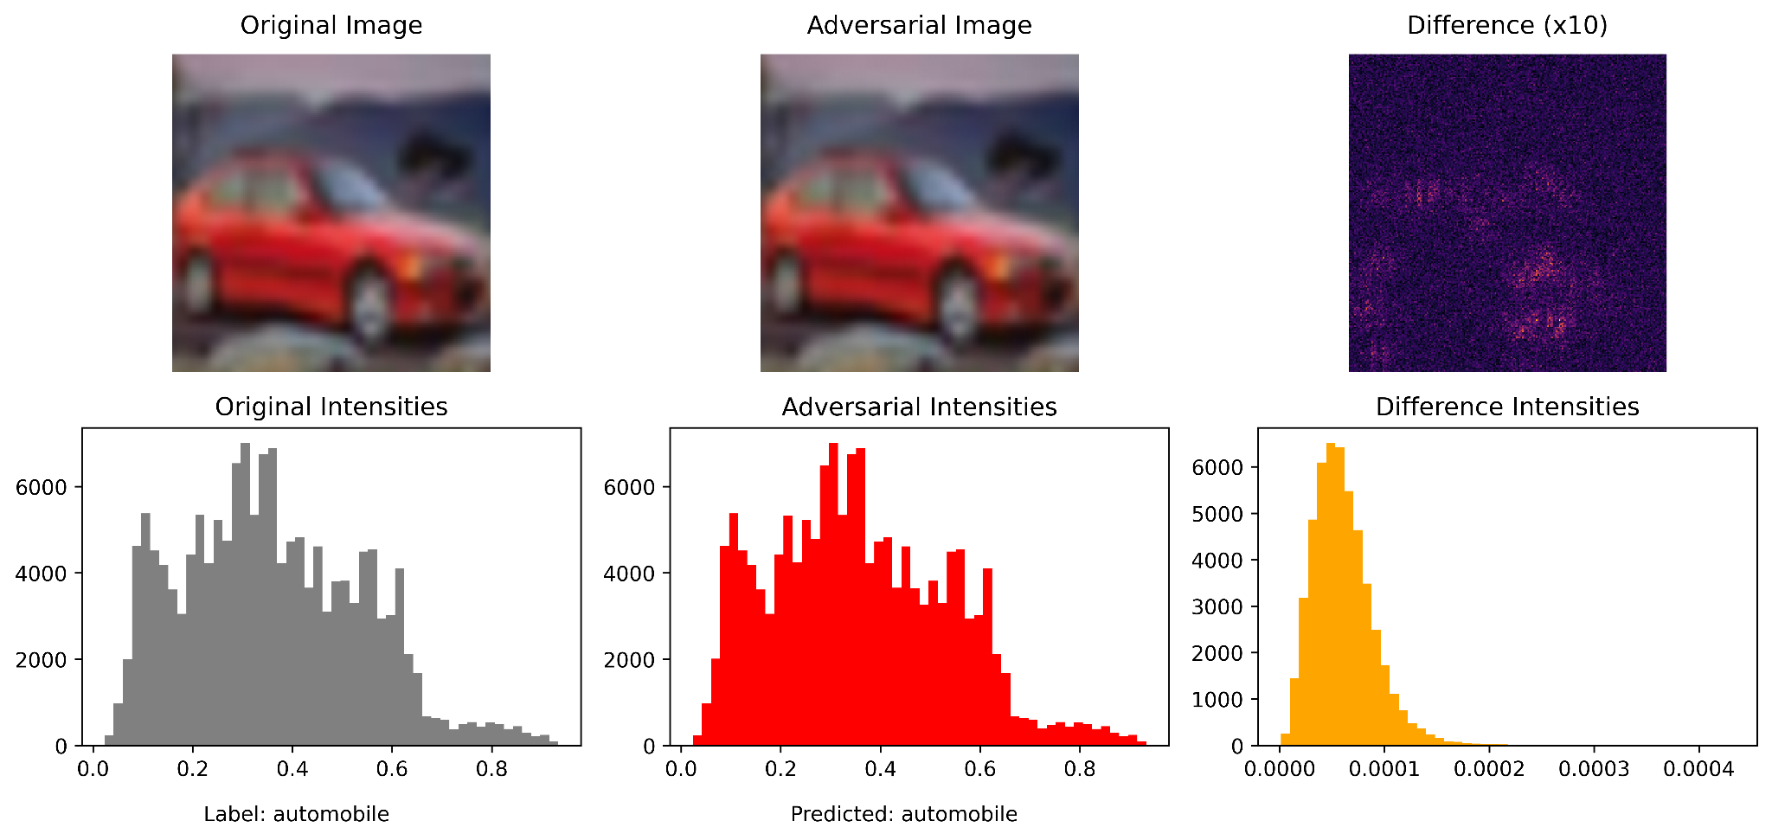
L2PGD

Slide 21
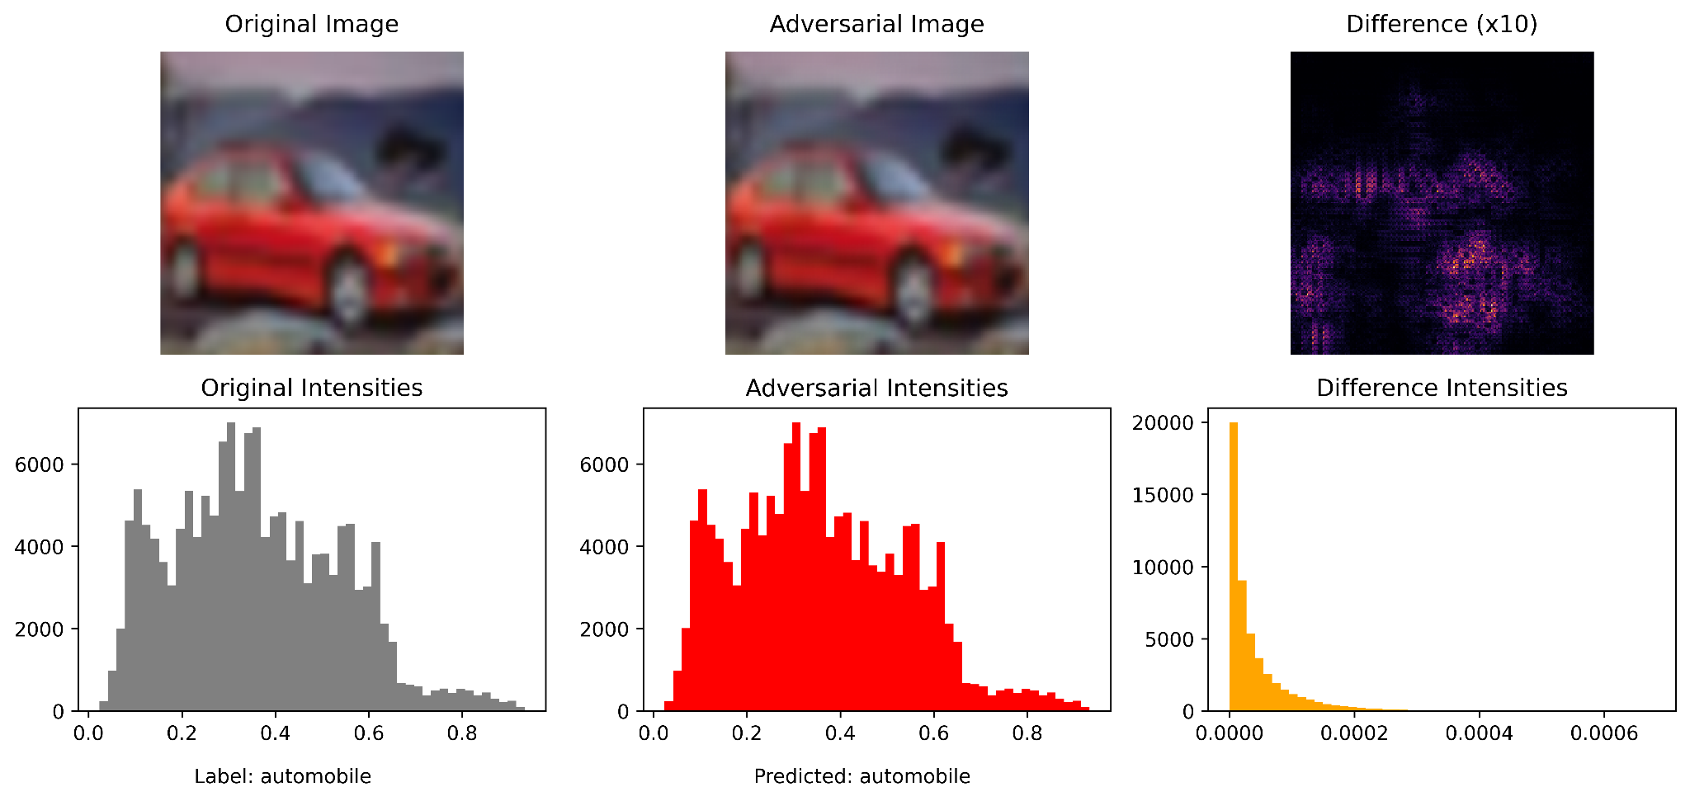
L2DeepFool

Slide 22
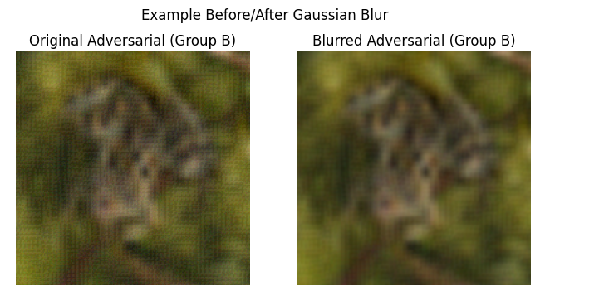
Gaussian Blurring Test
To mitigate adversarial attack effectiveness, we experimented with adding gaussian blurring as a preprocessing step

Slide 23
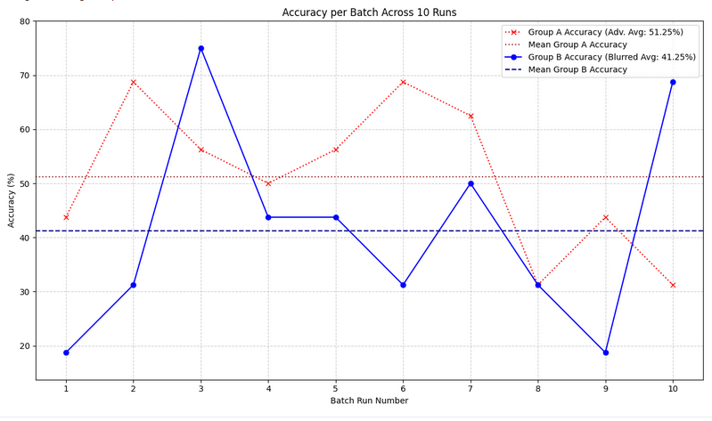
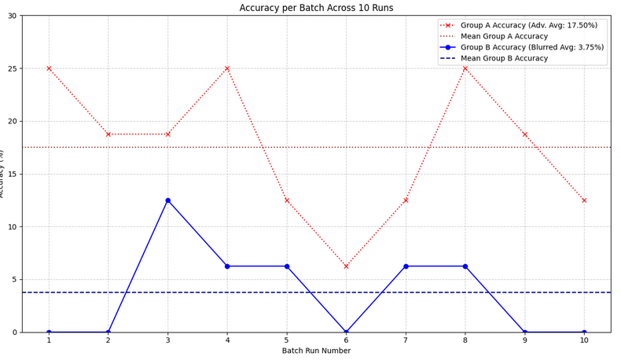
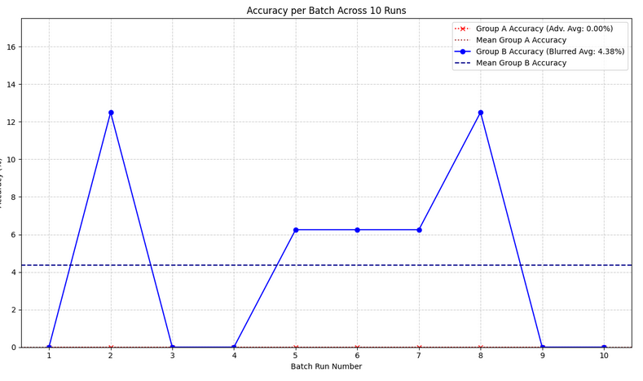
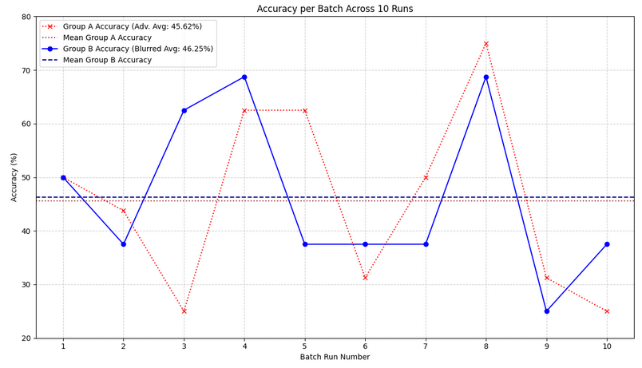
Robustness of robustness measures
L2PGD
To test ‘robustness’ of attacks before and after gaussian blurring, we inferenced over several random batches of attacked images before and after blurring
These graphs are emblematic of the trends of each of these attacks
FGSM
LinfPGD
DeepFool

Slide 24
Tying it all together
This project consisted of 2 separate optimizations attempts
Quantization
Robustness to Adversarial attacks
Next Steps:
Combine these efforts
First, test the robustness of the quantized model to these adversarial attacks
Second, apply robustness preprocessing/augmentation to the quantized model

Slide 25
Conclusions + Further Directions
Conclusions
Achieved 93.86% accuracy when transfer learning the RDNetTiny ImageNet-1k model to CIFAR10
We were able to quantize the RDNetTiny implementation (reduced model size by 75%), while still maintaining nearly 92%
Robust Adversarial Attack testing shows RDNetTiny is sensitive to these attacks
Gaussian Blur might be an effective mitigative measure
Further Directions
Try different types of quantization to include INT4 and Dynamic INT8
Retrain RDNetTiny for CIFAR10 with “attacked/perturbed” images

Slide 26
GitHub Repository
https://github.com/UGA-DeepLearning/RDNetTiny
All work completed in Jupyter notebooks for ease of recreation.

Slide 27
Code Demos

Slide 28
Thank You!

